Slide 1
Towards a Formal Specification of Multi-Paradigm Modelling
Moussa Amrani, Dominique Blouin, Robert Heinrich, Arend Rensink, Hans Vangheluwe, Andreas Wortmann
MPM4CPS Workshop. 15 September 2019
Co-located with the MoDels Conference, Munich, Germany

Slide 2
Science-y Definition of Paradigm
From Merriam-Webster [1]:
An example, a pattern; an outstandingly clear or typical example or archetype [1]
A framework containing the basic assumptions, ways of thinking, and methodology that are commonly accepted by members of a scientific community, and such a cognitive framework shared by members of any discipline or group [1]
A philosophical and theoretical framework of a scientific school or discipline within which theories, laws, and generalizations and the experiments performed in support of them are formulated
(Some) universally recognized scientific achievements that, for a time, provide model problems and solutions for a community of practitioners, i.e., [2]
what is to be observed and scrutinized
the kind of questions that are supposed to be asked and probed for answers in relation to this subject
how these questions are to be structured
what predictions made by the primary theory within the discipline
how the results of scientific investigations should be interpreted
how an experiment is to be conducted, and what equipment is available to conduct the experiment
[1] https://www.merriam-webster.com/dictionary/paradigm
[2] Kuhn, Thomas S. (1996). The Structure of Scientific Revolutions.

Slide 3




Object-Orientation on Gpls
[OO] Object Orientation [extracted from 1]
[OO1] | Shall possess the concepts of Class and Object
[OO2] | Objects shall possess a state and a set of capabilities / operations
[OO3] | Shall possess an inheritance mechanism
[OO4] | Inheritance shall allow operation reuse
[1] P. Wegner, “Dimensions of Object-Based Language Design,” SIGPLAN Notices, vol. 22, no. 12, pp. 168–182, Dec. 1987.

Slide 4




Object-Orientation on Gpls
[OO_WEG] Object Orientation [extracted from 1]
[OO1] | Shall possess the concepts of Class and Object
[OO2] | Objects shall possess a state and a set of capabilities / operations
[OO3] | Shall possess an inheritance mechanism
[OO4] | Inheritance shall allow operation reuse
[OO_Me] Object Orientation with Multiple Inheritance and …
[OO1] | Shall possess the concepts of Class and Object
[OO2] | Objects shall possess a state and a set of capabilities / operations
[OO3’] | Shall possess a multiple inheritance mechanism
[OO4] | Inheritance shall allow operation reuse
[OO5] | Shall use polymorphism with subtyping
[OO6] | …
[1] P. Wegner, “Dimensions of Object-Based Language Design,” SIGPLAN Notices, vol. 22, no. 12, pp. 168–182, Dec. 1987.

Slide 5
”Agile” Development
Our highest priority is to satisfy the customer through early and continuous delivery of valuable software.
Welcome changing requirements, even late in development. Agile processes harness change for the customer’s competitive advantage.
Deliver working software frequently, from a couple of weeks to a couple of months, with a preference to the shorter timescale.
…
Working software is the primary measure of progress.
[Agile_Me] Agile Development
[Agile1] | Shall follow a development lifecycle
[Agile2] | The full lifecycle, called macro, contains itself smaller, micro-lifecycles
[Agile3] | Each micro-cycle produces a working software
[Agile4] | Each micro-cycle last between 2 weeks and 4 months
[Agile5] | …
[1] Kent Beck et al. (2001). "Principles behind the Agile Manifesto". Agile Alliance. https://www.agilealliance.org/agile101/12-principles-behind-the-agile-manifesto/

Slide 6

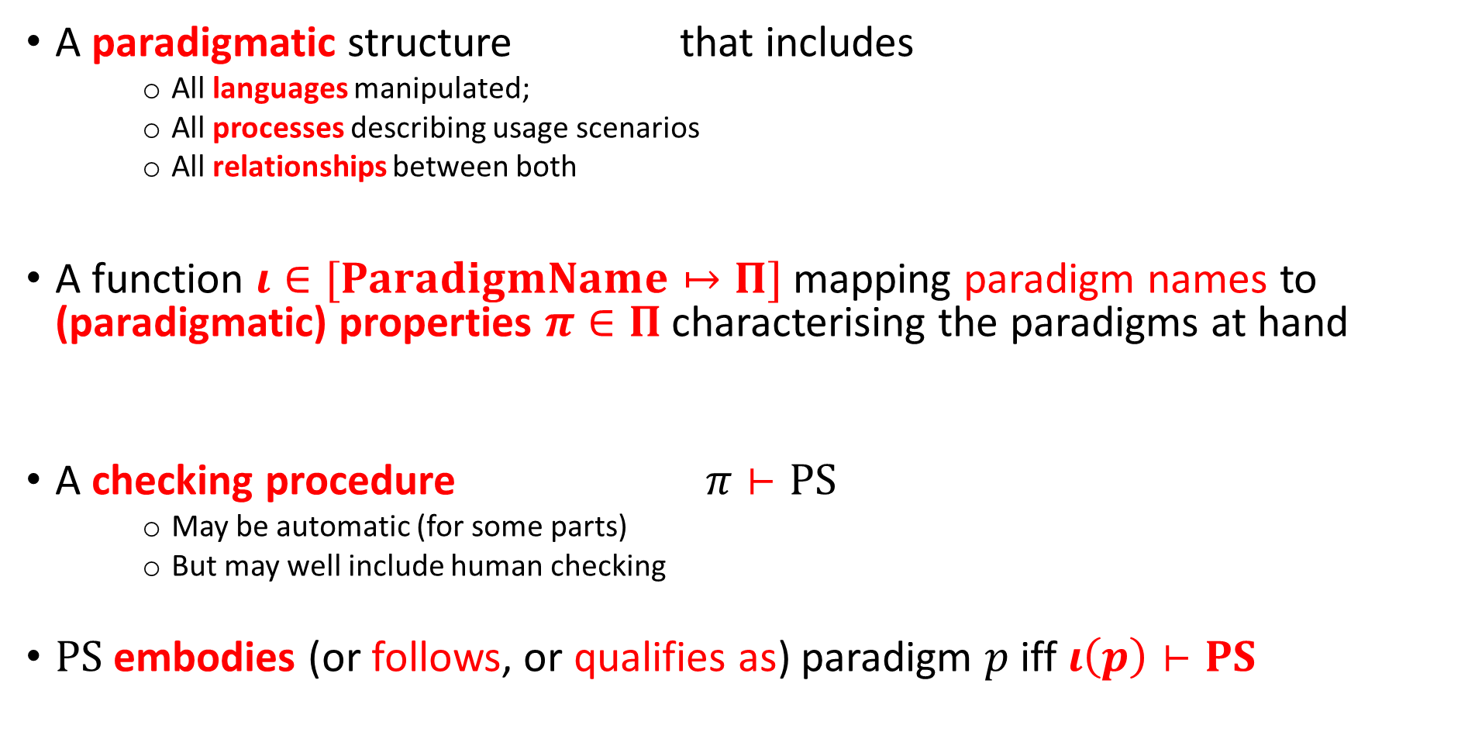
Our notion of Paradigm
A paradigmatic structure that includes
All languages manipulated;
All processes describing usage scenarios
All relationships between both
A function $ι∈[ParadigmName↦Π]$ mapping paradigm names to (paradigmatic) properties $π∈Π$characterising the paradigms at hand
A checking procedure $π⊢PS$
May be automatic (for some parts)
But may well include human checking
$PS$ embodies (or follows, or qualifies as) paradigm $p$ iff $ι\left(p\right)⊢PS$

Slide 7
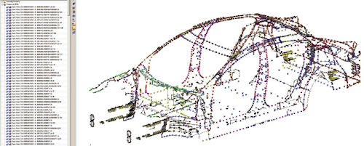
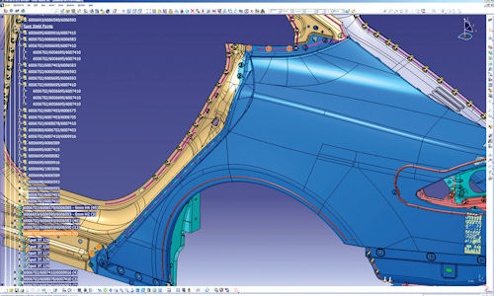
Cookie Computer-Aided Design

Slide 8
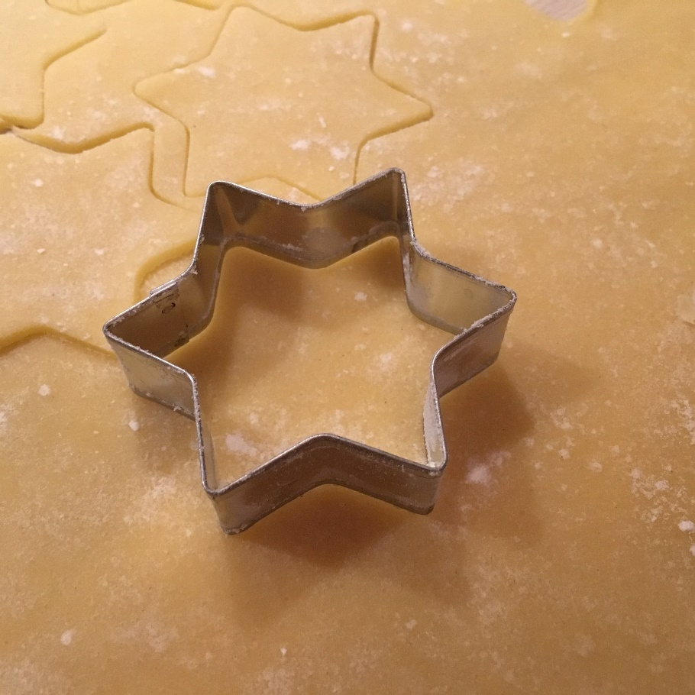
Cookie Computer-Aided Design & Manufacturing
y
Valid Cookie Cutter
shared lines
welded parts?
x
y
Invalid Cookie Cutter
crossing lines
“floating” points
x

Slide 9
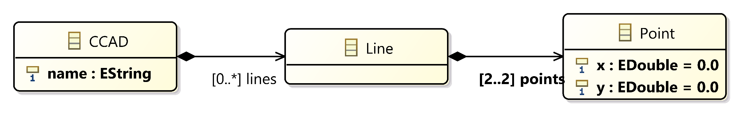
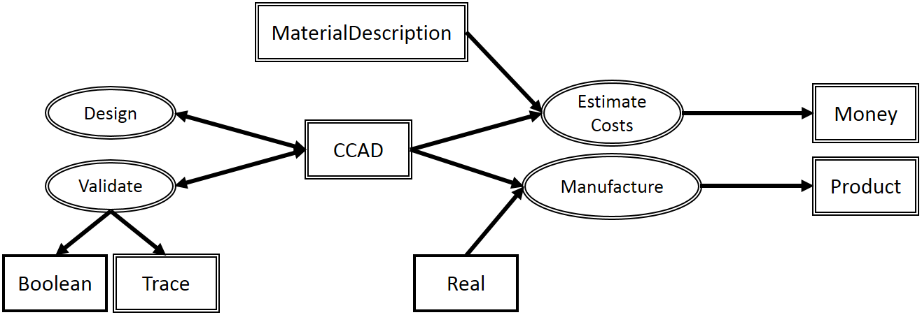
CookieCad MM + Processes
Ftg + Pm [1,2]
[1] L. Lúcio, S. Mustafiz, J. Denil, B. Meyers, and H. Vangheluwe. (2012). “The Formalism Transformation Graph As A Guide To Model-Driven Engineering,”, Tech. Rep. McGill University.
[2] L. Lúcio, S. Mustafiz, J. Denil, H. Vangheluwe, and M. Jukss, (2013). FTG+PM: An Integrated Framework For Investigating Model Transformation Chains. In International SDL Forum, pp. 182–202.

Slide 10
CookieCad Properties
[CookieCAD] CookieCAD Design & Manufacturing
[CookieCAD1] | Shall define points and lines in 2D
[CookieCAD2] | A Shape is defined by a valid set of lines
[CookieCAD3] | A valid shape ensures the following properties It does not contain crossing edges …
[CookieCADN] | The material shall have an acceptable strain factor
[CookieCADN+1] | A strain factor shall be comprised between ….
[CookieCADN+m] | An acceptable thickness shall be defined for manufacturing
… | …

Slide 11
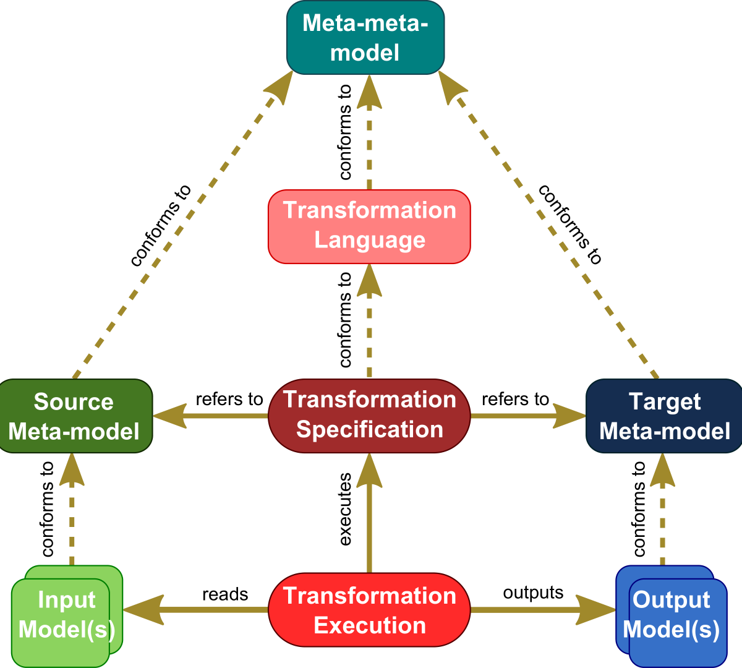
Enabler #1: Transformations

Slide 12
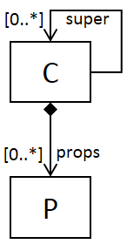
Enabler #2: “Template” MM
In Java, the structural part of the inheritance prop (OO1 – OO3) would correspond to the following:
C would match to Class or Interface
P would match to Member
super[0..*] would match to extends or implements, and multiplicity would be restricted to 1

Slide 13
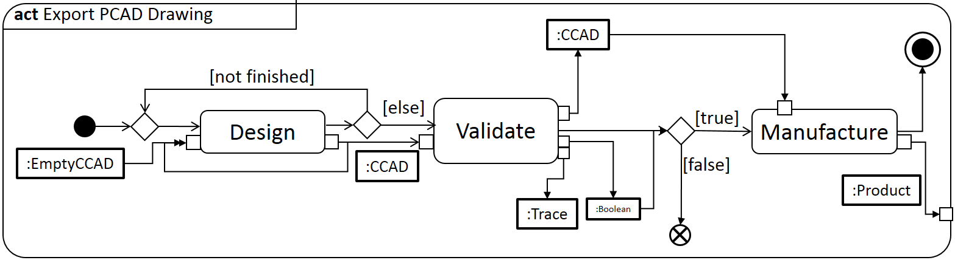
Enabler #3: “Template” Transformations
Transfo. Typing
+
« Interface » Correctness

Slide 14
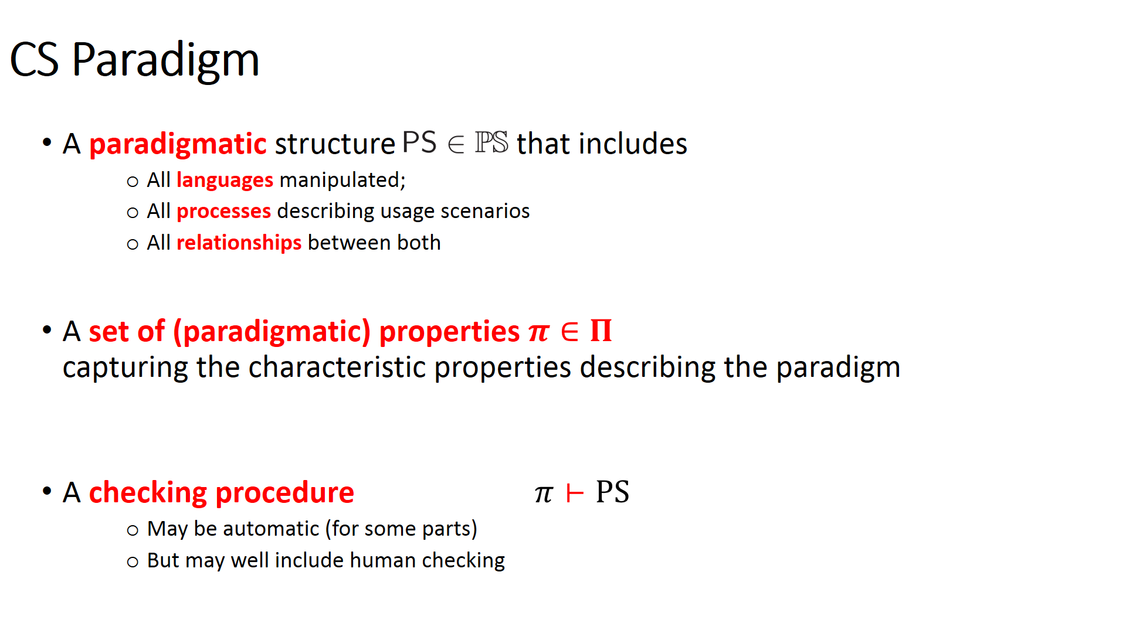
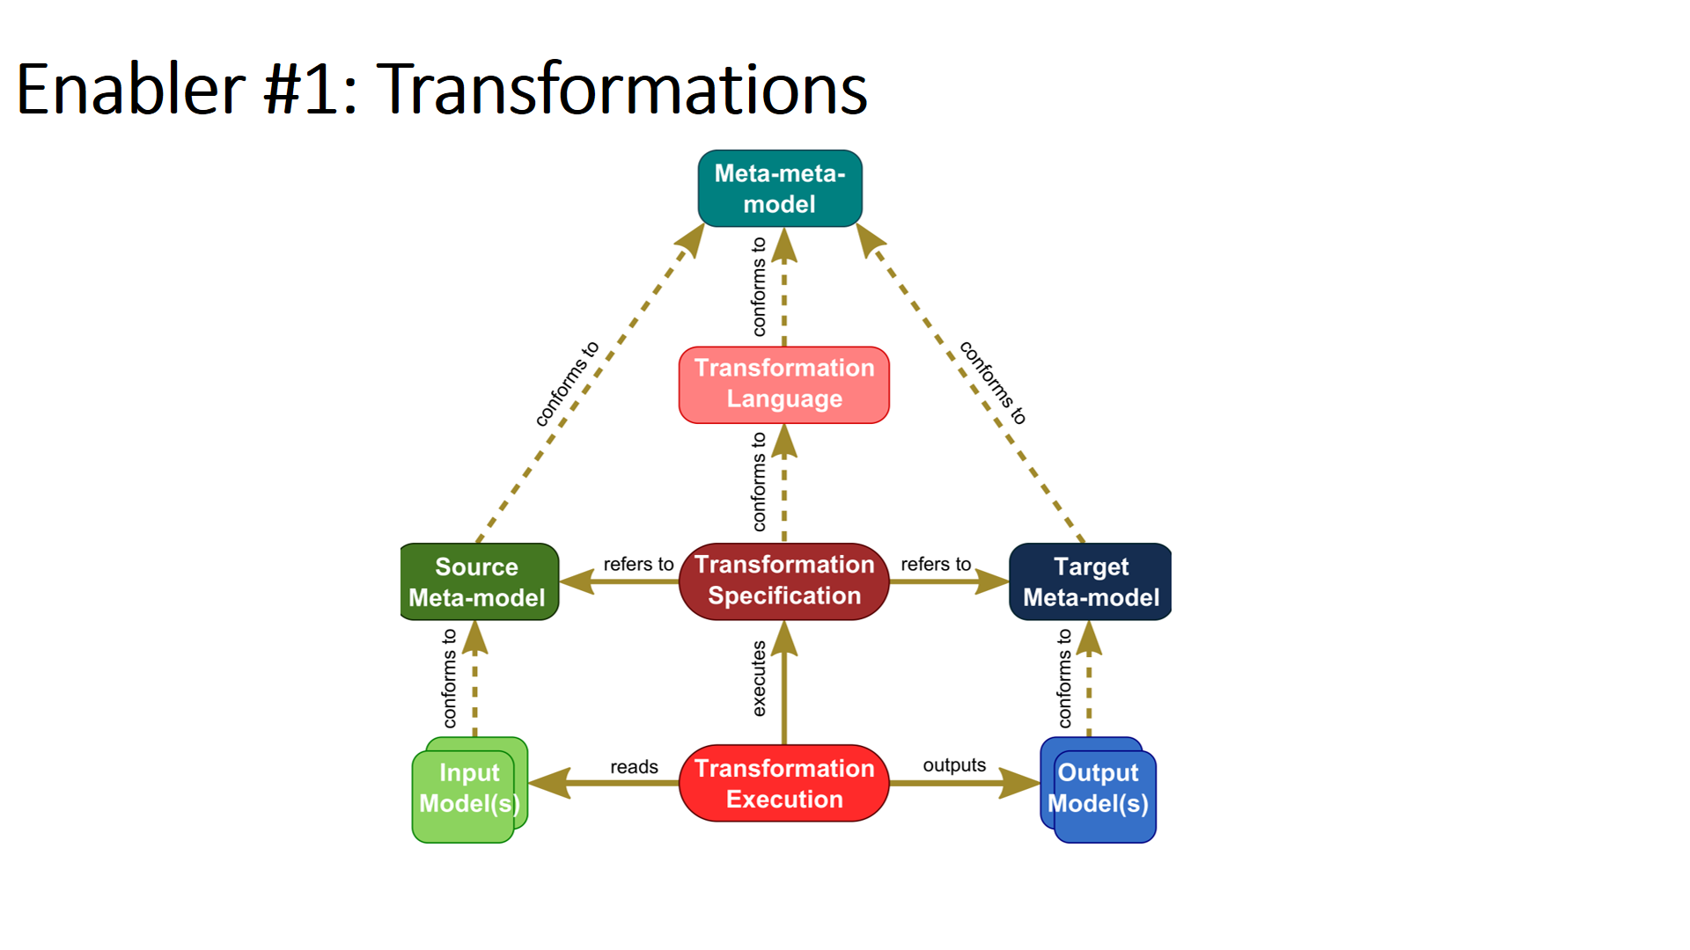
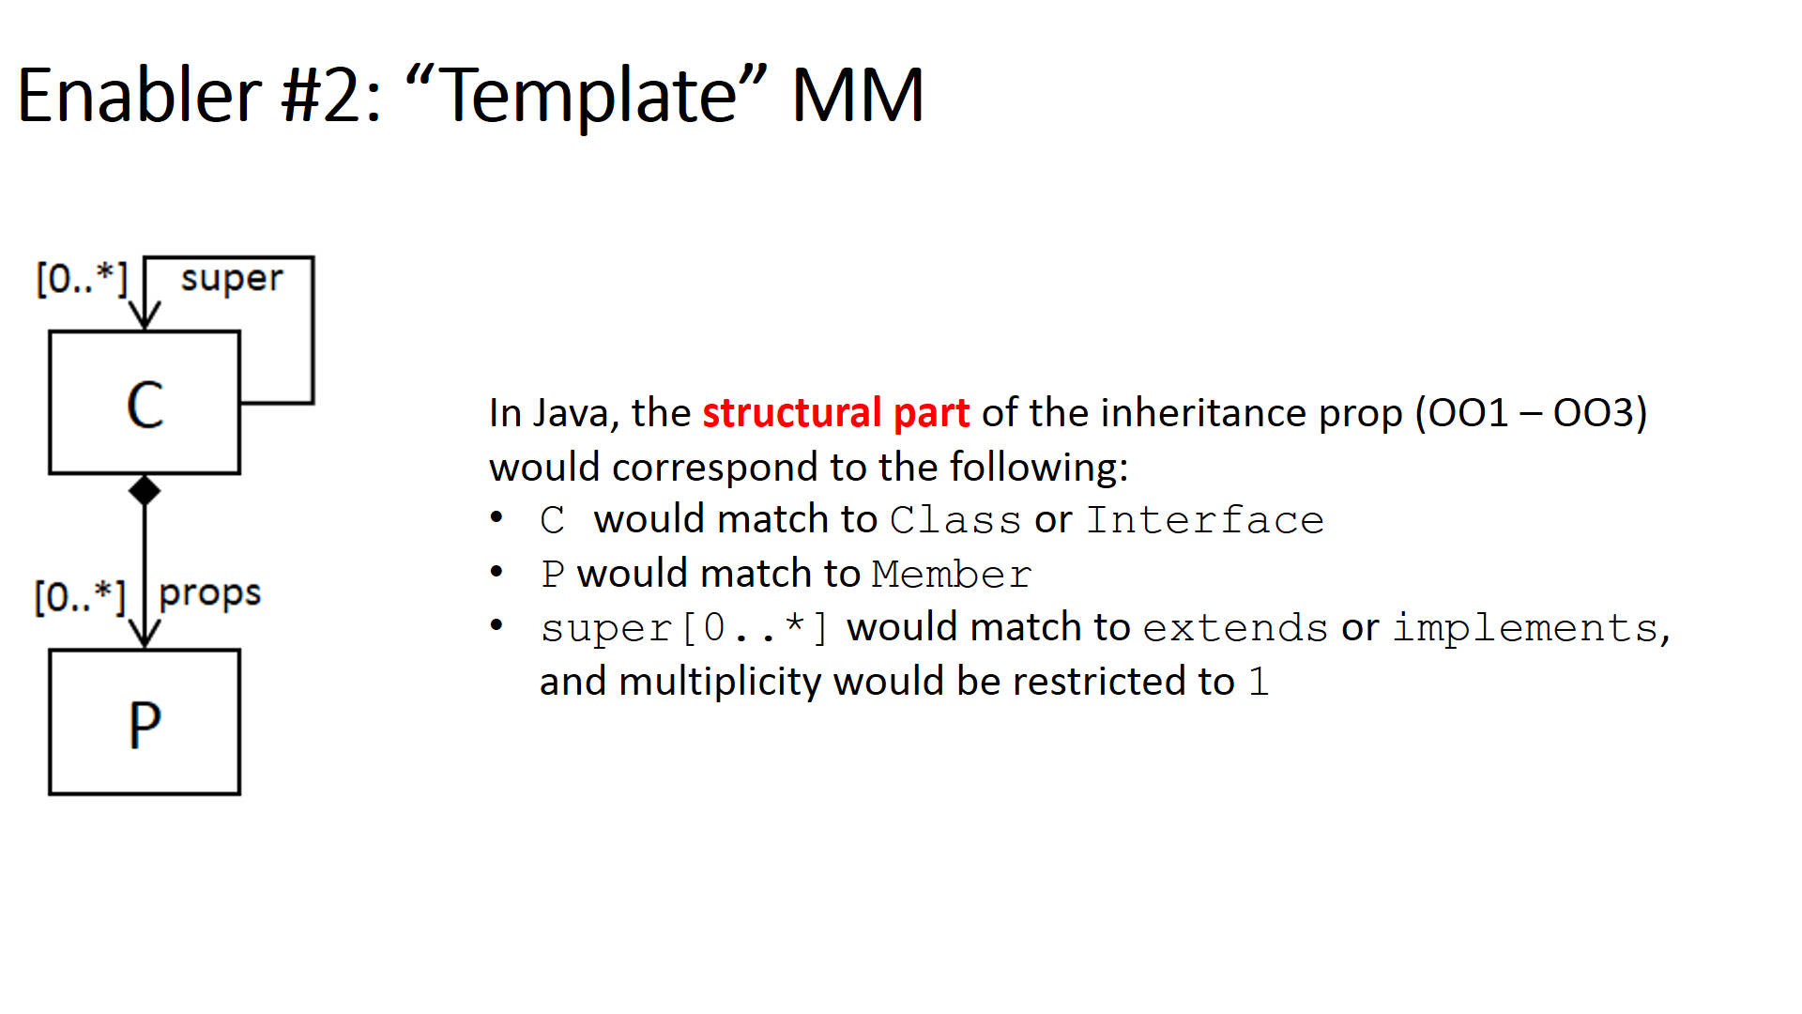
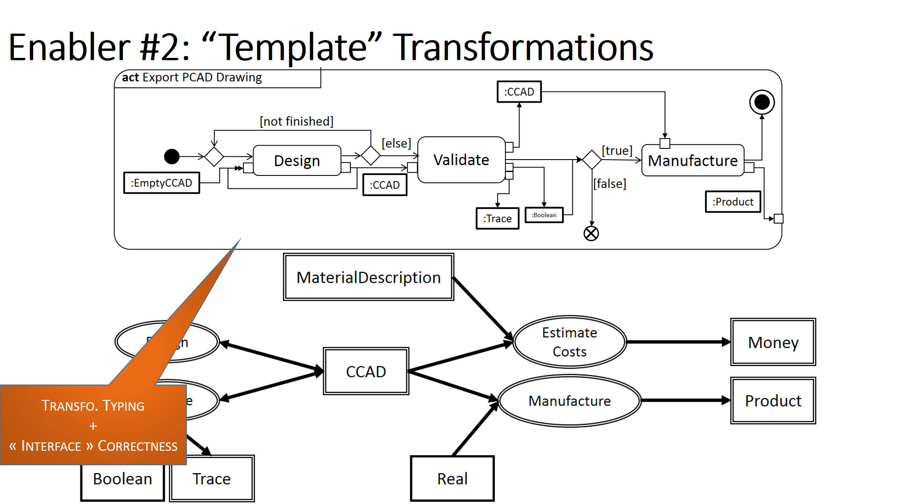

Conclusion

Slide 15
Towards Multi-Paradigm Modelling for CPS

Slide 16
Towards Multi-Paradigm Modelling for CPS
Relate Paradigms through relations (last, left-out component of the paradigmatic structure)
Come with their own sets of paradigmatic properties
Add “sanity-check” (paradigmatic) properties
Apply math. framework to real-life case studies
Study FTG+PM produced during previous COST Workshops
Illustrate with self-contained Use Cases (PowerWindows? HPI Lab Robotics? Other?)

